Slide 1
Text Summarization
Đào Việt Duy – 51603070
Nguyễn Duy Hàn Lâm – 196005004

Slide 2
References
https://www.analyticsvidhya.com/blog/2018/11/introduction-text-summarization-textrank-python/
https://www.analyticsvidhya.com/blog/2019/06/comprehensive-guide-text-summarization-using-deep-learning-python/

Slide 3
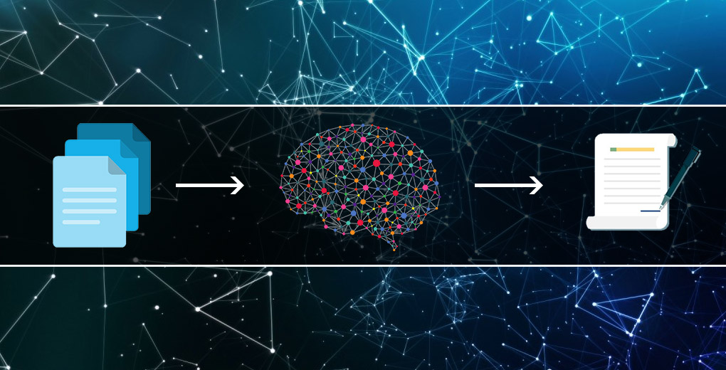
Text summarization

Slide 4
Text summarization
Text summarization
Abstractive summarization
Extractive summarization
Text
Sentence 1
Sentence 2
Sentence 3
Sentence 4
Text
Sentence 1
Sentence 2
Sentence 3
Sentence 4
Abstractive summarization
Summary
New sentences
Extractive summarization
Summary
Sentence 2
Sentence 4

Slide 5
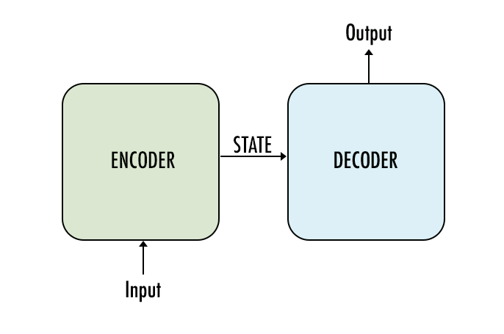
Sequence-to-Sequence

Slide 6
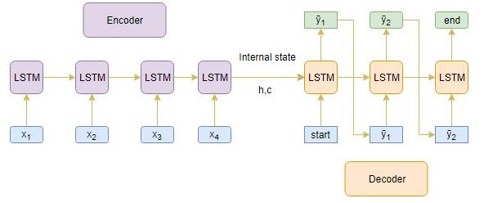
Sequence-to-Sequence

